Slide 1
Popular Sovereignty
Belief that “WE the PEOPLE” hold the power of government.
Give me one example…

Slide 2
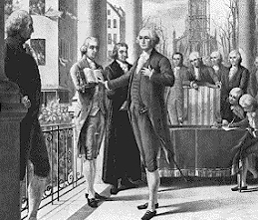
The government has limits on its power.
Give me on example…
Limited Government

Slide 3
We elect representatives to make decisions for the common good.
Give on example.
Republicanism

Slide 4
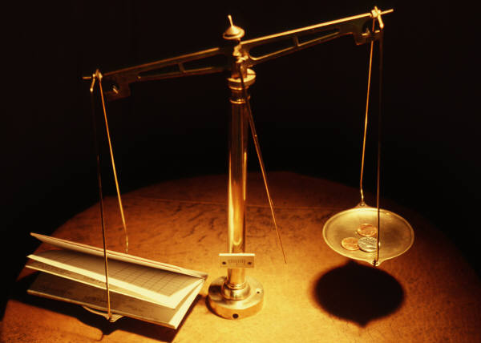
Each of the 3 branches can check the power of the other 2 in order to keep them balanced and equal.
Give one example.
Checks and Balances

Slide 5
We the people are governed by two bodies. A national a state government.
Name two national powers.
Name two state powers.
Name two shared powers.
Federalism

Slide 6
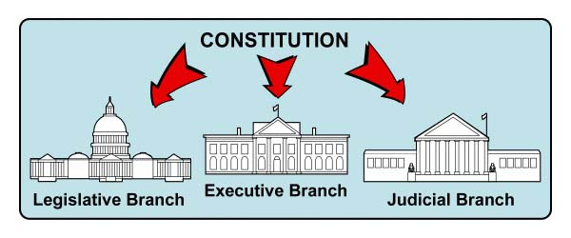
Each branch of the government has a specific function or power.
Give me one example…
Separation of Powers

Slide 7

Headed by the president, this branch enforces the laws.
Executive Branch

Slide 8
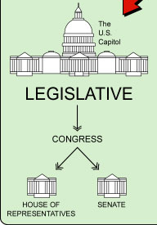
Congress (writes the laws) is divided into two houses.
House of Representatives, where seats are based on population.
Senate, where seats are equal.
Legislative Branch

Slide 9
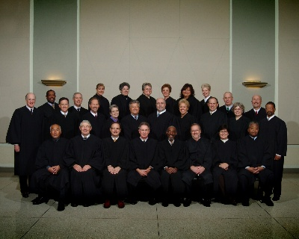
Headed up by the Supreme Court, this branch interprets the laws.
Judicial
Branch

Slide 10
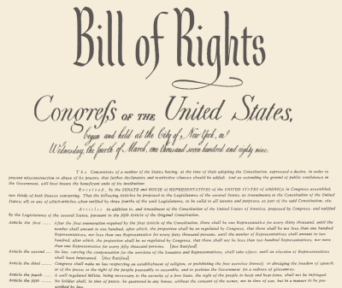
These are the rights guaranteed to all citizens in the Bill of Rights or the first 10 Amendments.
Individual Rights

Slide 11

Congress needed a way to amend or fix the constitution where it was imperfect. The constitution needed to be changed over time to reflect changes in attitudes.
Purpose of Amending

Slide 12
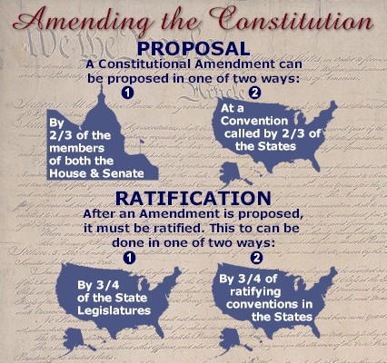
Process of Amending
Document proposed by 2/3 of Congress or the states.
Document approved by ¾ of the states.

Slide 13
Absolute Power Checks and Balances
King declared war Congress declares war
No trial by jury Amendment 6
Standing armies in homes 3rd Amendment
How did the Bill of Rights fix DOI

Slide 14
1st 10 amendments to the constitution.
Basic rights to protect individuals from the government.
Bill of Rights

Slide 15
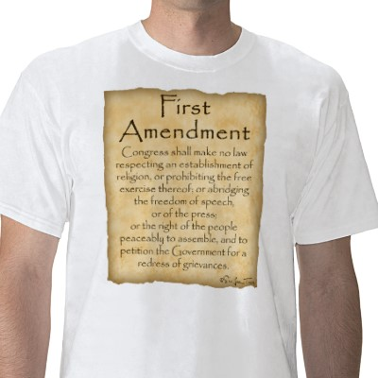
Freedom of:
Religion
Speech
Assembly
Petition
Press
* Give me an example.
1st Amendment

Slide 16

Right to bear arms….
Right of citizens to have firearms (guns)
2nd Amendment

Slide 17

The government cannot force soldiers to live in your house.
Give me an example.
3rd Amendment

Slide 18
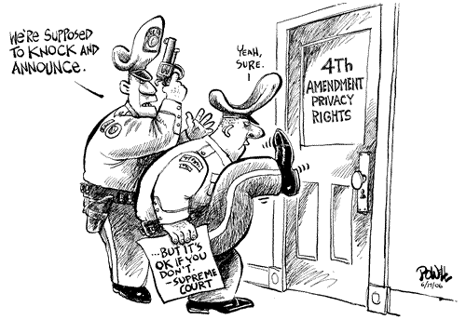
Search & Seizure
Government cannot enter your home without a warrant.
Give me an example
4th Amendment

Slide 19
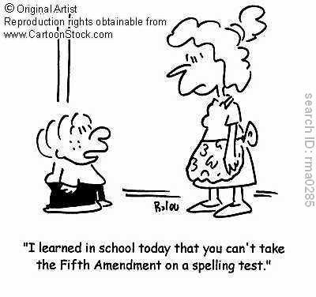
Due process…
Cannot be tried twice for the same crime
Plead the 5th
^{Give me one example…}
5th Amendment

Slide 20
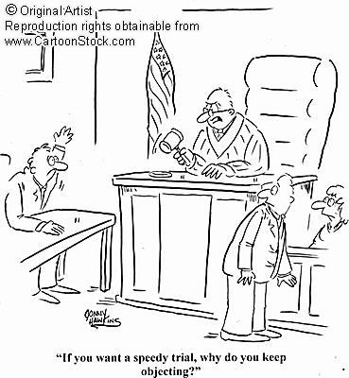
Right to a speedy trial
Right to a public trial
Right to a jury trial in a criminal case
Right to face accuser
Right to call witnesses
Give me one example…
6th Amendment

Slide 21
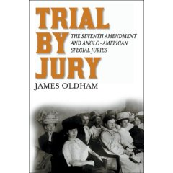
Trial by jury in civil cases.
Give me one example.
7th Amendment

Slide 22
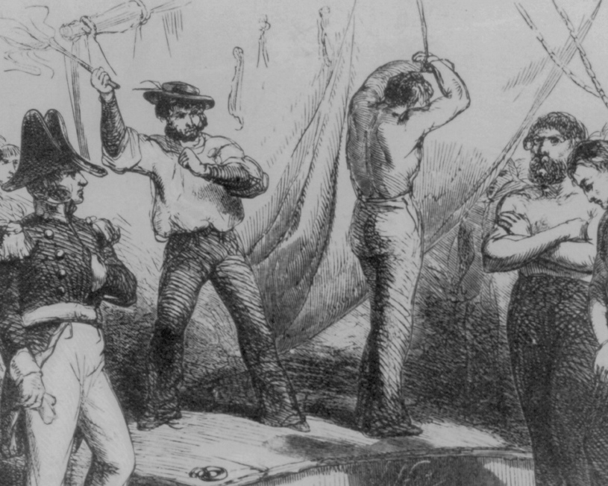
No cruel and unusual punishment
Reasonable Bail
Reasonable Fines
Give me one example…
8th Amendment

Slide 23
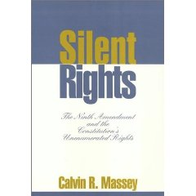
Citizens have more rights than are listed…
Give me one example…
9th Amendment

Slide 24

States’ Rights
Powers not given to the federal government are reserved for the states.
Give me one example…
10th Amendment

Slide 25
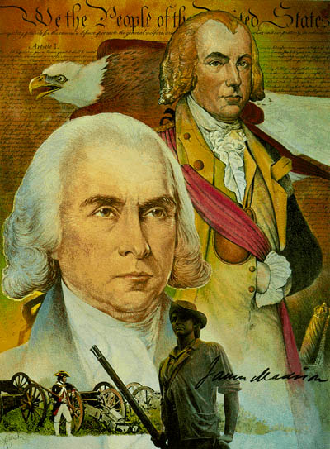
James Madison
“Father” of the Constitution.
His detailed notes tell us what actually happened in Philadelphia in 1787.
Supporter of the Federalist Papers

Slide 26
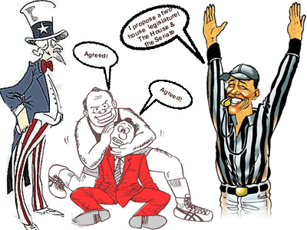
Great Compromise
Agreement on how to determine representation in Congress.
2 houses
Senate: 2 seats per state.
House of Representatives: seats based by population.

Slide 27
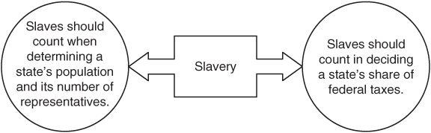
3/5 Compromise
Answered question on how slaves would be counted…
A slave would count as 3/5 of a person for taxation and seats in Congress.
1808 no more slave importation.
Fugitive Slave Law: return all runaways.

Slide 28
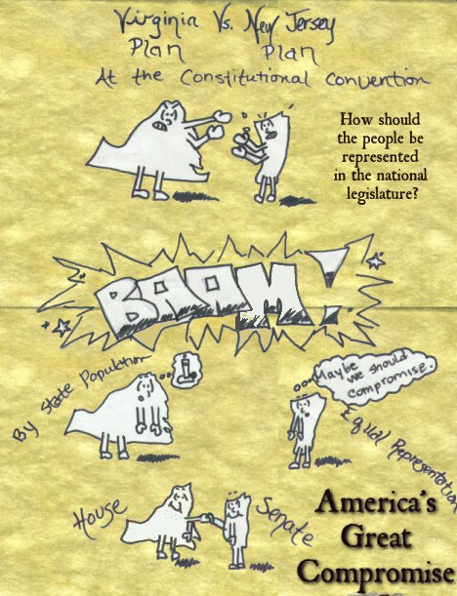
Virginia Plan
Legislature would have 2 houses.
3 branches
Seats in the houses would be based on population.
Favors LARGE states.

Slide 29
New Jersey Plan
Legislature would have 1 house.
3 branches
Each state would have 1 seat.
EQUAL representation.
Favors SMALL states.

Slide 30
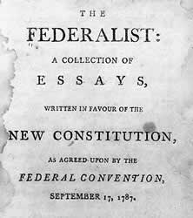
The Federalist Papers
Series of essays written to encourage ratification of the Constitution.
Hamilton, Madison, and Jay

Slide 31
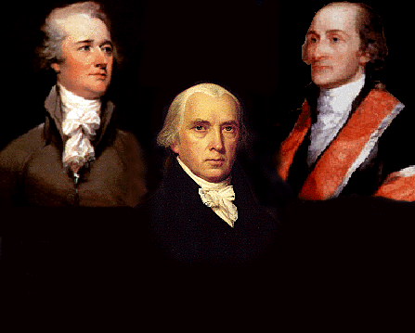
Federalists
Strong National Government
Strong Executive Branch
Equal powers among branches of government

Slide 32
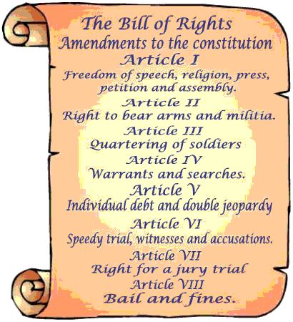
Anti-Federalists
Strong State governments
Weak Executive branch
Legislative branch the strongest
Wanted a Bill of Rights.

Slide 33
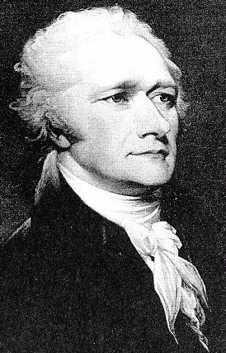
Alexander Hamilton
Author of many of the Federalist Papers.

Slide 34
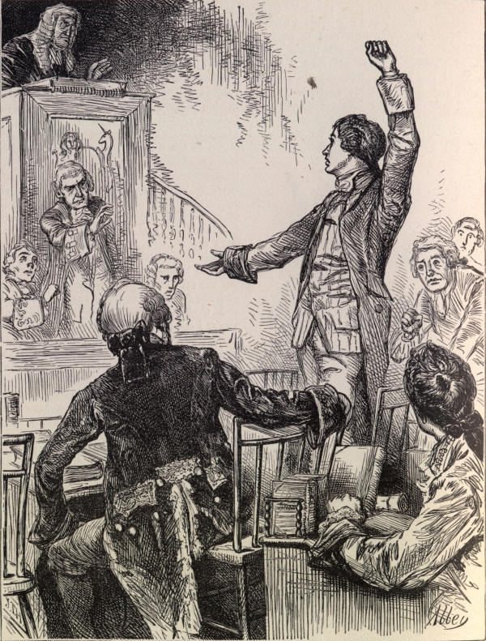
Patrick Henry
“smelled a rat” at the convention.
Favored strong state government.
Distrusted George Washington.

Slide 35
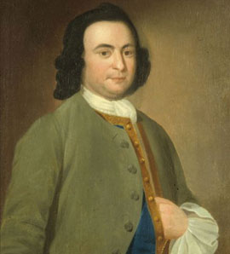
George Mason
Refused to sign the Constitution.
Insisted on a Bill of Rights added to Constitution.

Slide 36
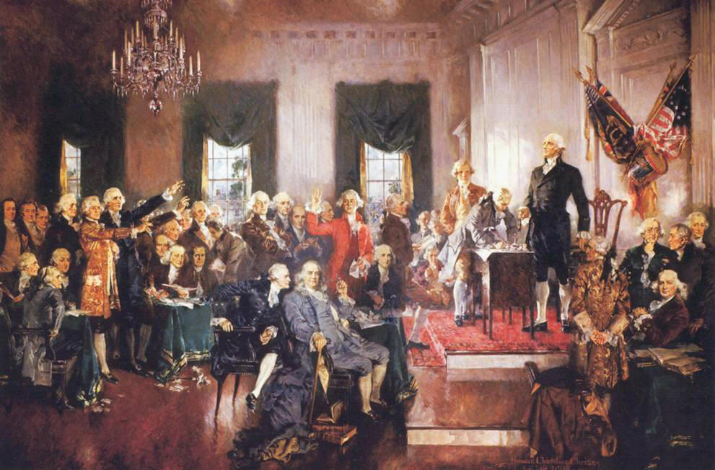
Philadelphia Convention
Also known as the Constitutional Convention.
Ignoring public opinion, delegates decided to write a new constitution in 1787.

Slide 37
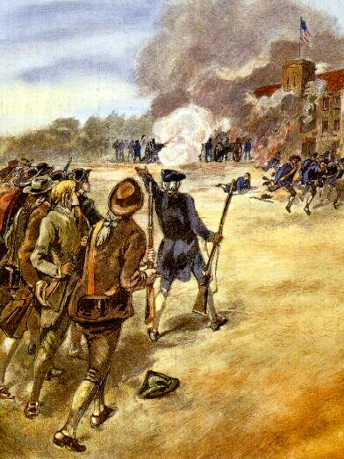
Shays’ Rebellion
Daniel Shays’ and other farmers protested taxes. His rebellion showed the national government was too weak to control the country.

Slide 38

States’ Rights
Idea that rights of the states cannot be taken away by the national government.

Slide 39
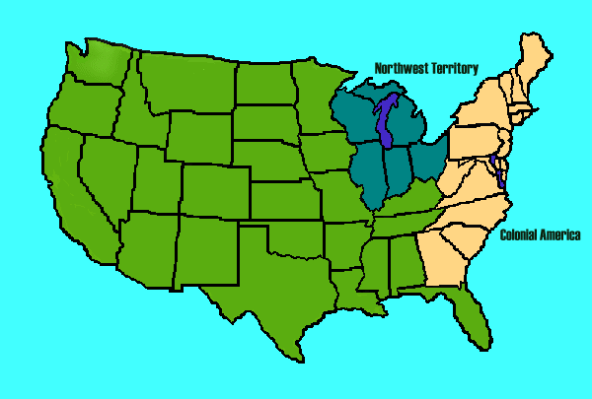
Northwest Ordinance
1787
Set rules for how a territory would become a state.
60,000 people the territory could become a state
Slavery outlawed in Northwest Territory
rivers were open to everyone.
Freedom of religion
Trial by jury

