Slide 1
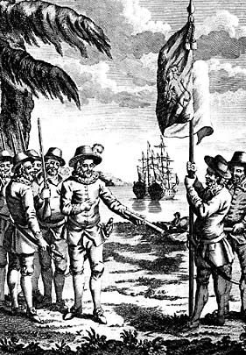
Roanoke
The first English attempt to colonize North America. The colony of __________ failed after one year.

Slide 2
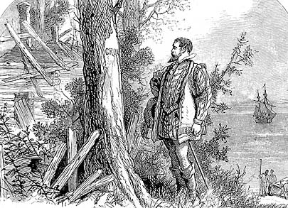
“The Lost Colony”
The second English attempt to colonize North America ended with an entire colony missing!
All that was left were the letters “CRO” carved in a tree.

Slide 3
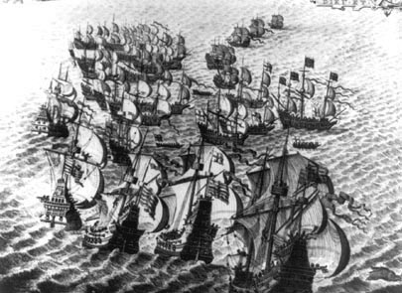
Spanish Armada
The _____________was defeated by England in 1588.
England became the most powerful country and had control of the seas and colonization of North America.

Slide 4
The YEAR the first permanent English colony was founded.
1607

Slide 5
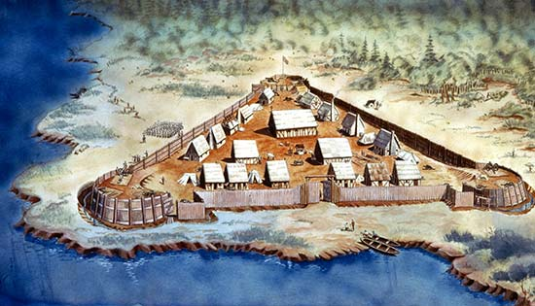
was the first successful English colony in North America. It was founded in 1607.
Jamestown, Virginia

Slide 6
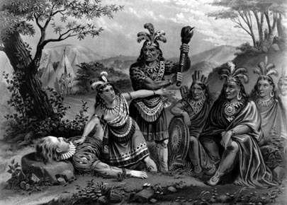
In 1608, __________takes over the colony.
He announces that, “He that will not work shall not eat.”
He convinces the Powhatan tribe to trade for corn.
John Smith

Slide 7
Tobacco
John Rolfe developed this high quality plant.
This crop saved and made Jamestown a successful colony.
CASH CROP- $$$

Slide 8
Slavery
These individuals arrive in Jamestown in 1619 to provide an inexpensive labor force for plantation owners.

Slide 9
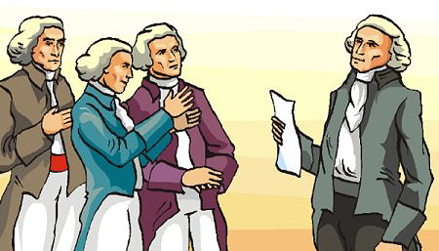
House of Burgesses
_____________was founded in Virginia in 1619. This legislature was elected to make laws for the colony.

Slide 10
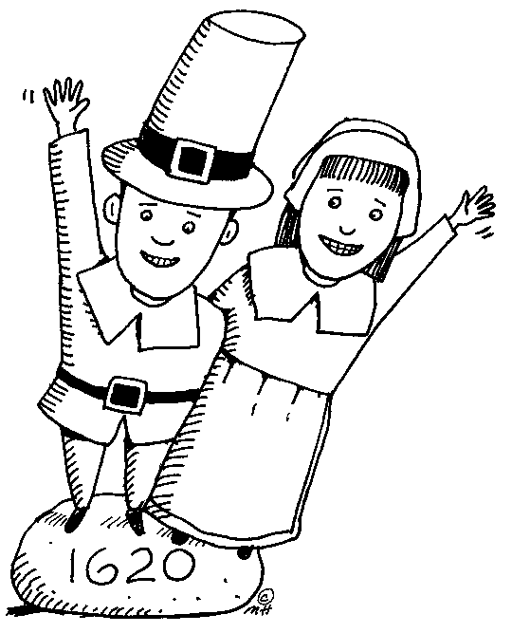
In 1620, these colonists land in northeastern coast of North America (Massachusetts). They start the religious colony of Plymouth to be separate from the Church of England.
Pilgrims

Slide 11
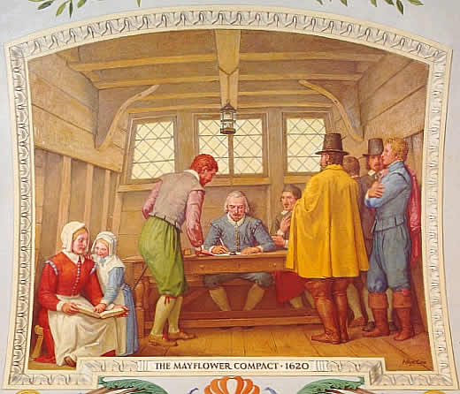
Mayflower Compact
Pilgrims drafted this document before they left the Mayflower in order to provide safety though majority rule and self government.

Slide 12

In 1630, this group came to the Massachusetts area to start a colony that would be the perfect religious community. Unfortunately this colony was started for religious freedom but refused to grant religious freedom to others.
Puritans

Slide 13
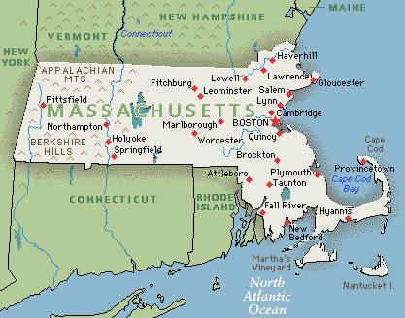
Massachusetts
________________was formed by the Massachusetts Bay colony annexing (taking over) the Plymouth colony and the area that is now known as Maine. Boston was the largest city in the colonies until the mid 1700’s.

Slide 14
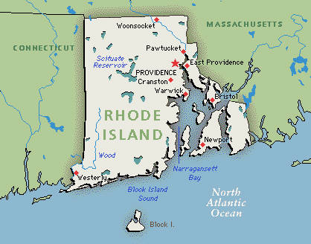
Rhode Island
founded by Roger Williams for religious toleration in 1636 after he was banished from Puritan Massachusetts.

Slide 15
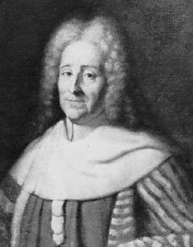
Baron de Montesquieu
Writer whose ideas on Separation of Power and Checks and Balances influenced the US Constitution.

Slide 16
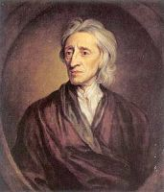
John Locke
Philosopher
Natural Rights: Life, Liberty and property.
Key ideas of Dec. of Ind. And US Constitution.

Slide 17
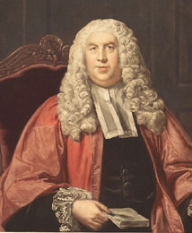
William Blackstone
English lawyer
Writings influenced colonists towards representative government.
Phrases in the Declaration of Independence asserting the "self-evident" "unalienable Rights" of people granted by "the Laws of Nature and of Nature's God“
including the prohibition of taxation without consent.

Slide 18
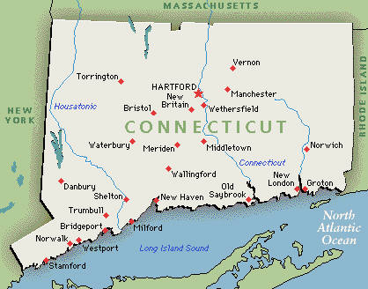
Connecticut
_____________was founded by Thomas Hooker in 1636. It was an economic colony, but many religious dissenters came from Massachusetts.

Slide 19
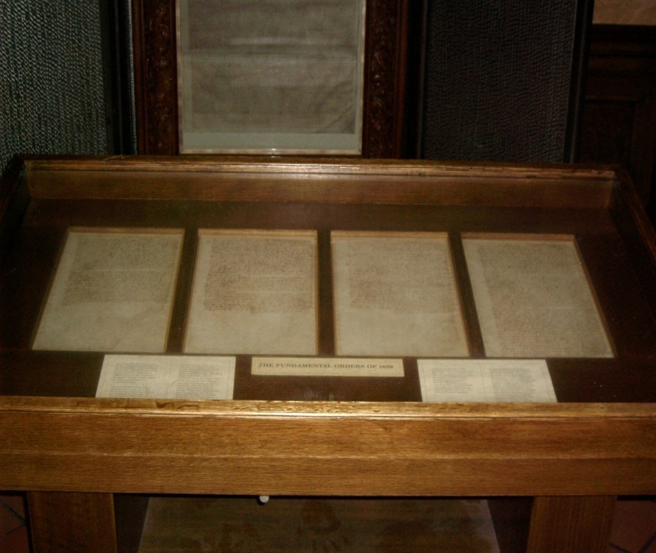
Fundamental Orders of Connecticut
The first written constitution in North America.

Slide 20
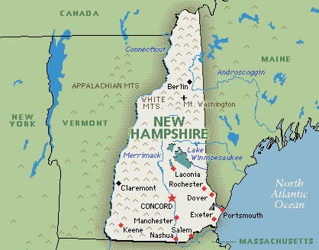
New Hampshire
____________ was founded mainly for economic purposes in 1623. Religious dissenters also came here for religious freedom.

Slide 21
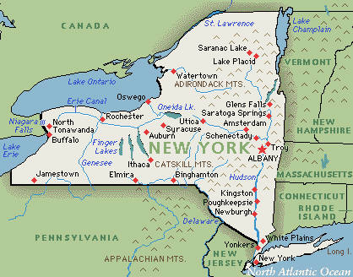
New York
_____________was originally settled by the Dutch in 1624. In 1664, the Dutch surrendered the area to the English. It was founded as an economic colony.

Slide 22
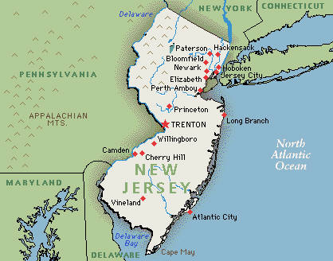
New Jersey
This colony was also taken by the English from the Dutch in 1664. ______________was an economic colony.

Slide 23
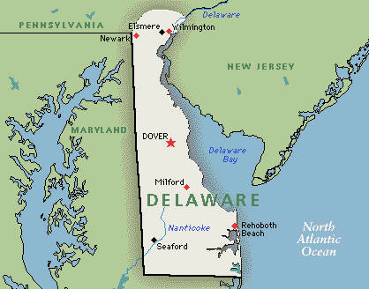
Delaware
Dutch settlement started in 1638. This colony was also taken by the English from the Dutch in 1664. William Penn took over the colony in 1682 until it became independent in 1701.

Slide 24
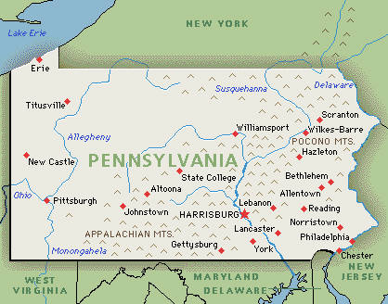
Pennsylvania
In 1681, William Penn receives a land grant from the King of England. He founds the colony of ___________as a religious haven (safe place) for Quakers.

Slide 25
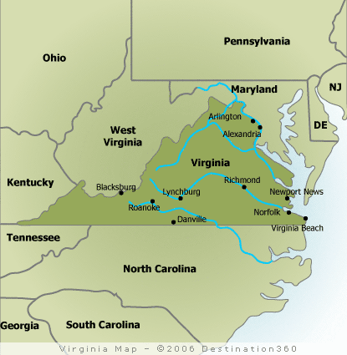
This colony was founded in 1607 as an economic colony. The original colony included West Virginia; when Virginia left the Union at the start of the Civil War, West Virginia demanded that they stay with the United States and became their own state.
Virginia

Slide 26
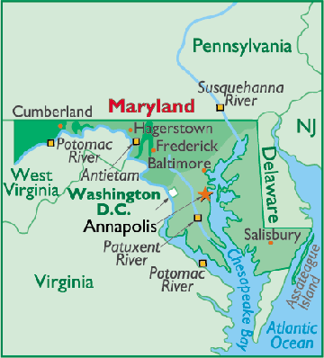
Maryland
In 1635, Cecil Calvert (Lord Baltimore) founds a colony as a haven for Roman Catholics.

Slide 27
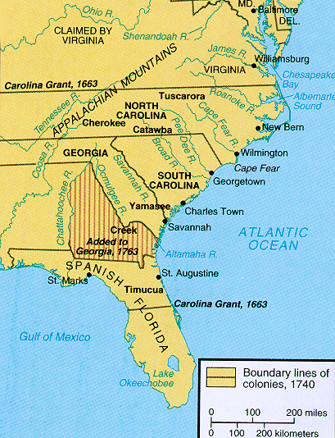
North/South Carolina
These colonies were founded in 1663 as an economic colony. In 1691, the Carolina’s split into two separate colonies.

Slide 28
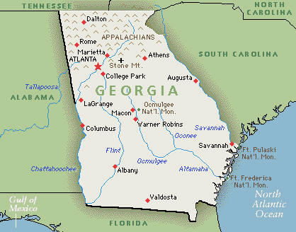
Georgia
Georgia was founded in 1733 as a buffer (bumper) from Spanish North America and as a place England could send its debtors (people that owe $) from prison.

Slide 29
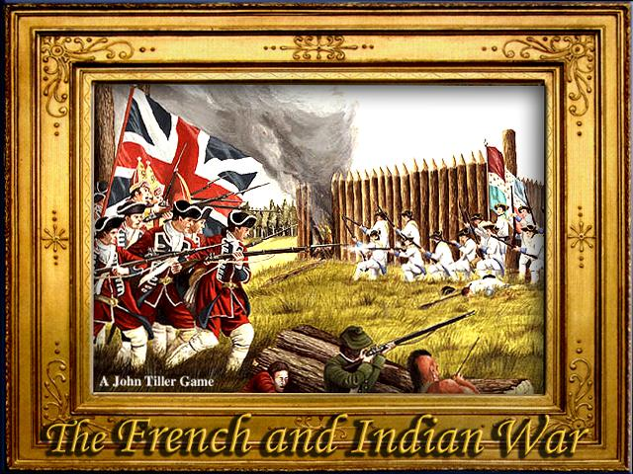
In the 1750s, France and Britain were fighting in Europe. The war was now spreading to North America. British Colonists wanted to take over French land in North America. The British wanted to take over the fur trade in the French held territory. In the peace treaty of 1763 the British got most of the French land in North America. Also as a result of the war, the British began taxing the colonists to pay for the war.
French/Indian War

Slide 30
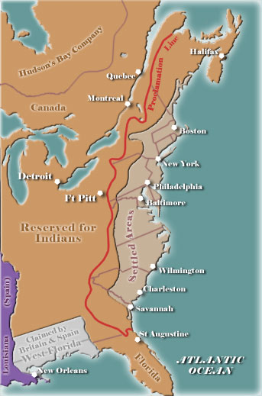
In 1763, Parliament and the King agreed to a new Proclamation which called for peace-making actions toward the Indians. Land-Grants were forbidden in the area reserved for Indians. British settlers were forbidden to settle west of the Appalachian Mountains. Those who had already settled in such lands were forced to relinquish their property. The colonists would not accept this and refused to follow this new law.
Proclamation of 1763

Slide 31
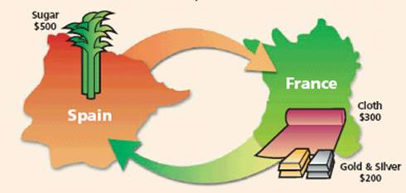
Mercantilism
Economic system where colonies supply “Mother” country with resources and receive manufactured products in return.
Eliminates foreign competition
Eliminates factories in the colonies.

Slide 32
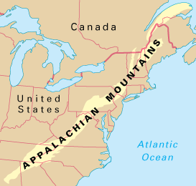
Appalachian
Mountains
Western boundary of the original 13 colonies

Slide 33
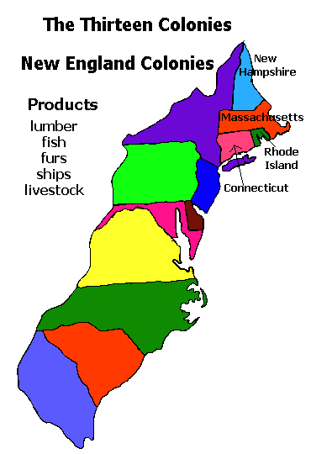
New England Region
Northernmost region
Consisted of fishing, shipping and lumber.
Massachusetts
Rhode island
Connecticut
New Hampshire

Slide 34
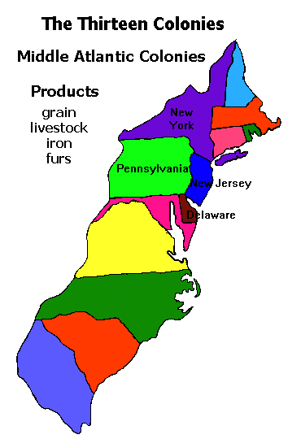
Middle Region
Known as the “Bread Basket”
Grains, mills, iron works
New York
Pennsylvania
New Jersey
Delaware

Slide 35
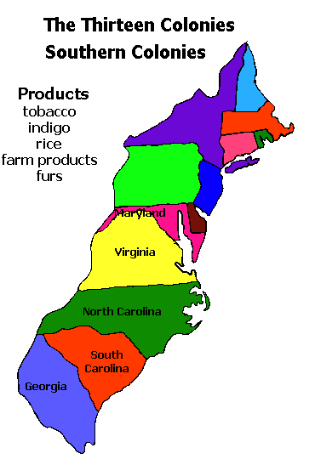
Southern Region
Tobacco, rice, indigo
Plantations
Slaves
Virginia
Maryland
South Carolina
North Carolina
Georgia

Slide 36
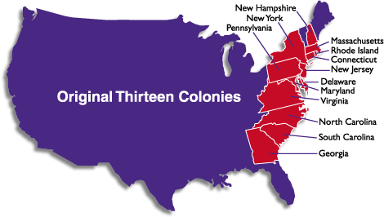
Chronological order of colonies
Virginia
Massachusetts
New Hampshire
Maryland
Connecticut
Rhode Island
Delaware
North Carolina
South Carolina
New Jersey
New York
Pennsylvania
Georgia

Slide 37
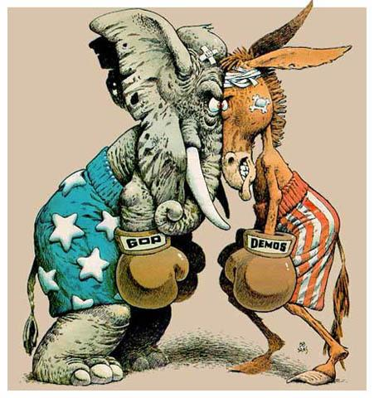
Political Reason
Reason for colonization such as:
Expanding empire
Buffer against other countries

Slide 38

Economic Reason
Reason for colonization such as:
Wealth
Gold
Money
Job

Slide 39
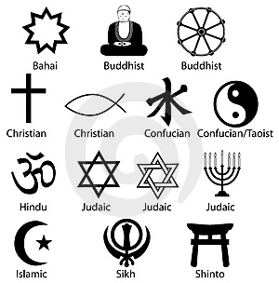
Religious Reason
Reason for colonization such as:
Religious toleration
Religious freedom
Spread Catholicism

Slide 40
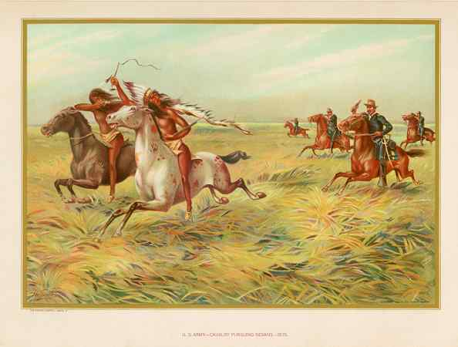
Native Americans
This group of people lost an extensive amount of land, resources and lives to disease to the colonists from Europe.

Slide 41
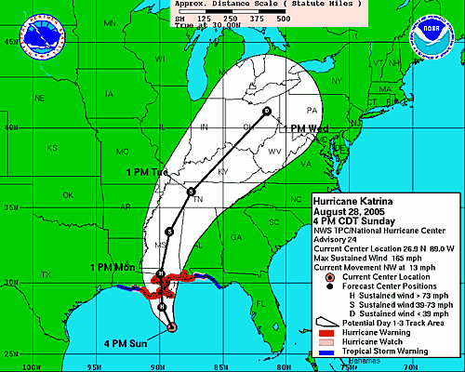
Maps
Students should know how to interpret information from a variety of maps. Look at the textbook!!!

Slide 42
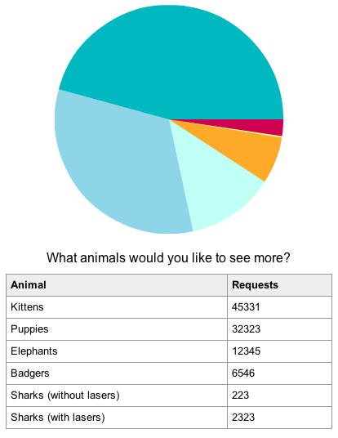
Charts
Students should know how to interpret information from a variety of charts. Look at the textbook!!!

